Slide 1
TEST-DRIVEN DEVELOPMENT
Group presentation
1.Desire
2.Carmel
3.Dickson

Slide 2
Presentation Outline
01
02
03
04
Introduction
Definition, Cycle, implementation processes
Opportunities
The opportunities of adapting TDD approaches
Challenges
The challenges associated with the use of TDD
Conclusion
Why TDD matters

Slide 3
01
INTRODUCTION

Slide 4
INTRODUCTION TO TEST-DRIVEN DEVELOPMENT
Testing is one of the most important aspects of any software development project.
Traditionally, software testing is done after the developer has finished writing the code. The software is then checked for defects and errors at the end, where it can take a lot of time
TDD is a software programming practice that emphasizes test-first development. The developer comes up with the tests before the code.

Slide 5
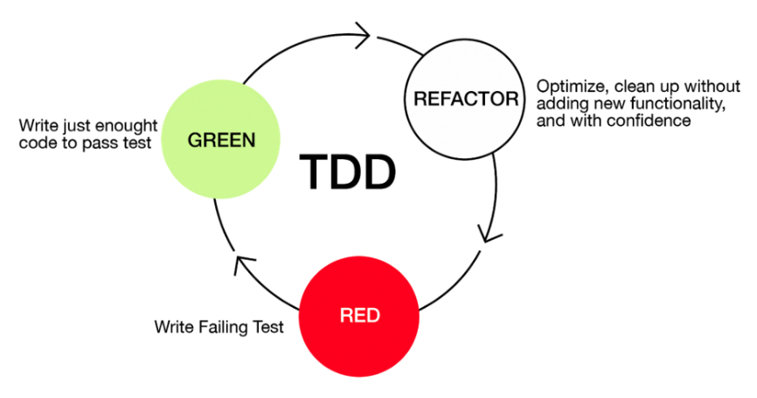
THE CYCLE OF TDD
The cycle of TDD follows the Red-Green-Refactor cycle:
i. Red - Write a failing test.
ii. Green - Write code that is just enough to make the test pass.
iii. Refactor - Optimize, then clean up the design.

Slide 6
TDD IMPLEMENTATION PROCESSES
i. Write the test
The developer starts by writing a test that defines a small requirement of the software
ii. Run test to see if it fails
Once the test is created, the next step is to run them for the first time, where it should fail.
iii. Write the functionality
At this point, the developer begins writing the code that ensures the test pass and nothing more.

Slide 7
TDD IMPLEMENTATION PROCESSES
iv. Run the test again
The developer should rerun the test using the codes written in the previous step.
v. Refactor the code
Once the tests pass, the developer should now clean the written codes to make sure it adheres to standards.

Slide 8
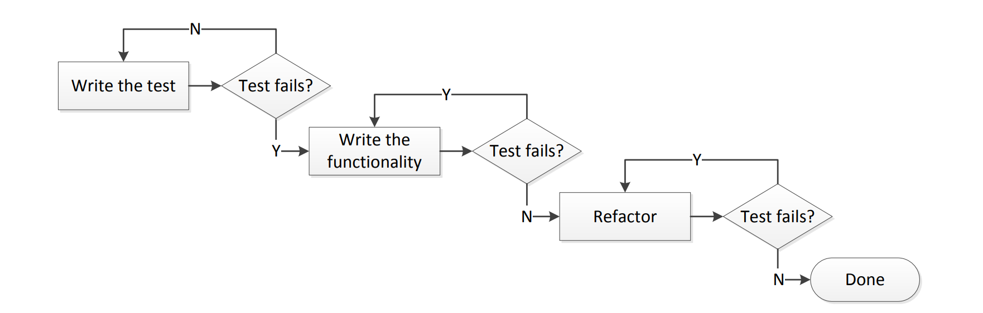
TDD IMPLEMENTATION PROCESSES
Test-Driven Development Processes. Source: (Madeyski & Kawalerowicz, 2013)

Slide 9
LEVELS OF TDD
i. Acceptance TDD
The tests are written from the users’ point of view which satisfies the software requirement..
ii. Developer TDD
The tests are written from the developer’s point of view, which satisfies the software requirement.

Slide 10
02
OPPORTUNITIES

Slide 11
1. Improved code quality Produces clean and more meaningful code 2. Refactoring leads to perfectly well-working code Restructuring code while not changing its original functionality.
OPPORTUNITIES

Slide 12
3. Better application quality The application developed is released with fewer defects, leading to increased software reliability. 4. Produces code that is easy to maintain The code developed using refactoring is considered more readable and easier to maintain.
OPPORTUNITIES

Slide 13
5. Team productivity and motivation When the developed code finally passes the tests, developers are motivated to continue working because they have the assurance that what they have developed is what the client need 6. TDD allows room for changes as per the customer’s needs Focus is given to only one feature of the software until it meets the needs of the users.
OPPORTUNITIES

Slide 14
7. TDD enables incremental development When all functionalities of the system are not known at the beginning of the project, the team can work on what is known at the time, and there is room for scalability.
OPPORTUNITIES

Slide 15
03
CHALLENGES

Slide 16
1. Takes time for TDD to be understood by everyone. Takes time to make it understandable to everyone on the development team. 2. Team leader biasness It is common for the development team leader to base his explanation of TDD’s advantages solely on his personal experience without taking into account the opinions of his team .
CHALLENGES

Slide 17
3. Developers’ perspective on TDD. Upper It takes new team members several months to shift their perspective toward TDD 4. Misunderstanding from the upper management Upper management occasionally misinterprets the TDD process when they claim that developers spend more time creating tests than working on functional code.
CHALLENGES

Slide 18
5. Learning TDD process gets monotonous and boring. Learning TDD methodology and implementing it can get boring because the process of writing tests for an existing system, refactoring application code, and refactoring tests. 6. Increase development time. Considering the time spent to implement a certain set of requirements, it is difficult to measure the duration spent while developing a software product.
CHALLENGES

Slide 19
04
CONCLUSION

Slide 20
TDD is beneficial to development teams and the organization as a whole because it comes with many opportunities for the team. However, to maximize these opportunities, team leaders should be careful enough not to base the readiness of the team to use TDD based on their own personal experiences but rather invest in empowering all the members of the development team.
CONCLUSION

Slide 21

Thanks!
Do you have any questions?

